Slide 1


Foundations of
Scientific Computing
(SciComp 101)
Dave Biersach
dbiersach@bnl.gov
Session 06
Polar Coordinates

Slide 2
Session 06 – Goals
Install the latest PyQT package to support interactive graphical desktop applications
Understand the Red-Green-Blue (RGB) triplet color encoding scheme
Draw a circle using Polar to Cartesian coordinate conversion
Plot parametric equations using polar graphs
Appreciate the amplitude, frequency, and phase of waves
Trace the waveform of two sinusoids in superposition
Draw the Archimedes Spiral

Slide 3
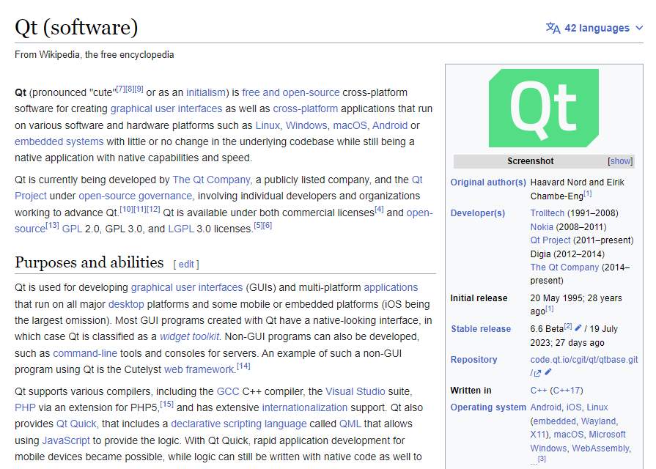
Python User Interfaces via Qt
https://en.wikipedia.org/wiki/Qt_(software)

Slide 4

Python User Interfaces via Qt6
https://www.qt.io/product/qt6

Slide 5
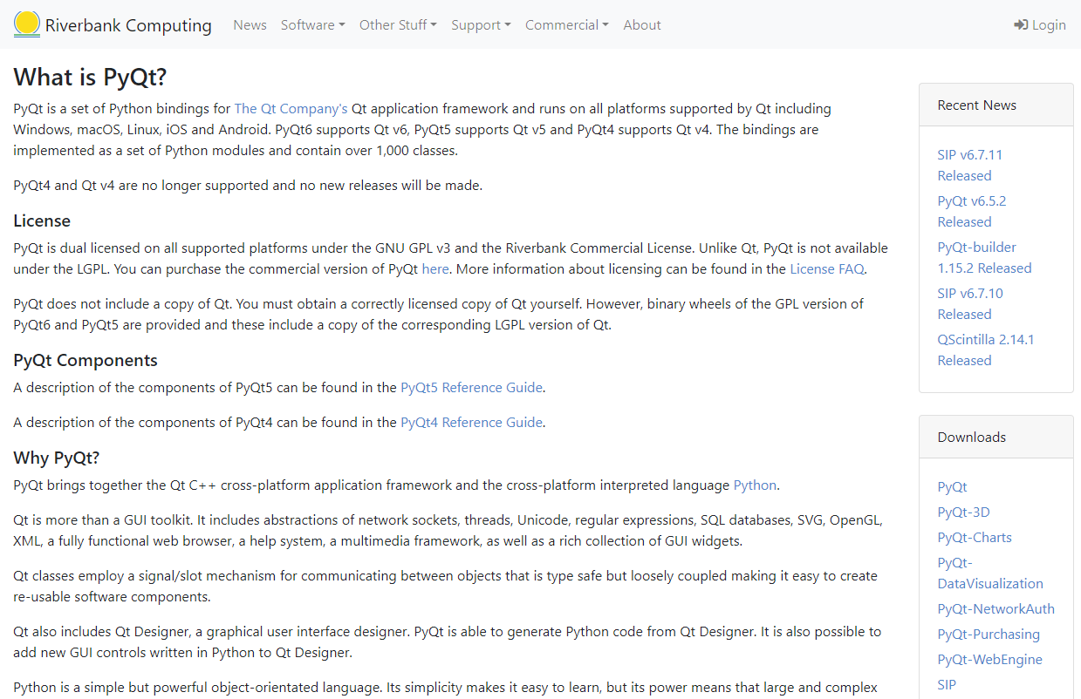
Python User Interfaces via PyQt6
https://www.riverbankcomputing.com/software/pyqt

Slide 6
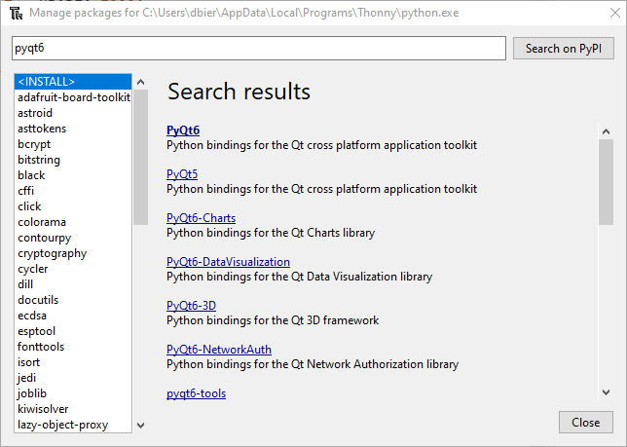
Install the PyQt6 Package

Slide 7
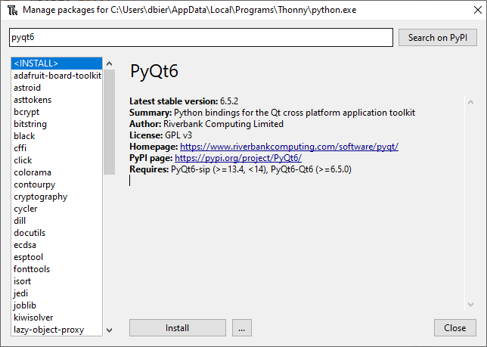
Install the PyQt6 Package

Slide 8
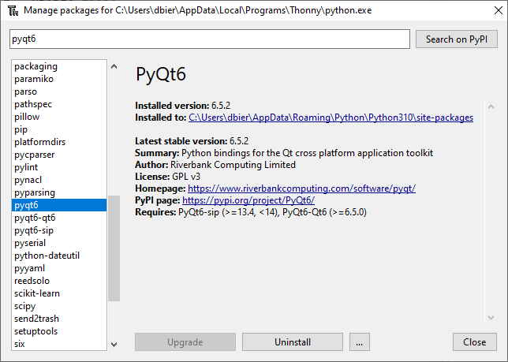
Verify the PyQt6 Package Installation

Slide 9
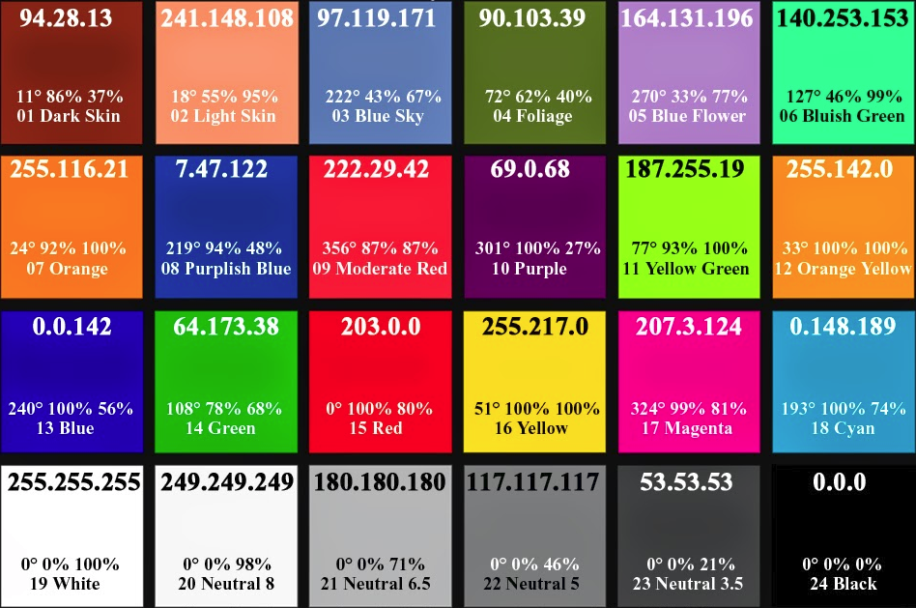
Red-Green-Blue (RGB) Color Values

Slide 10
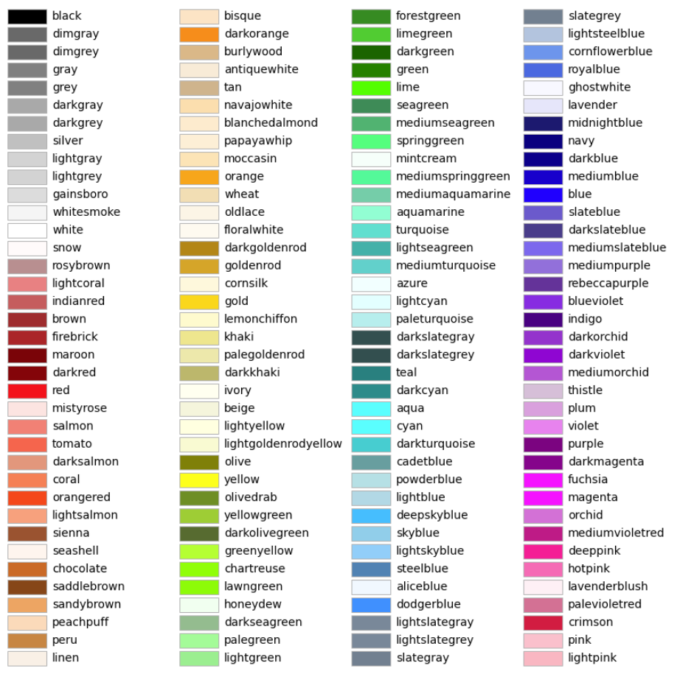
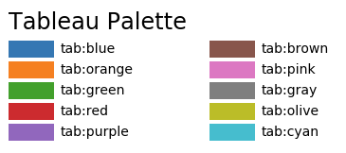
Predefined Matplotlib Color Names (all lowercase)
①
②
③
④

Slide 11
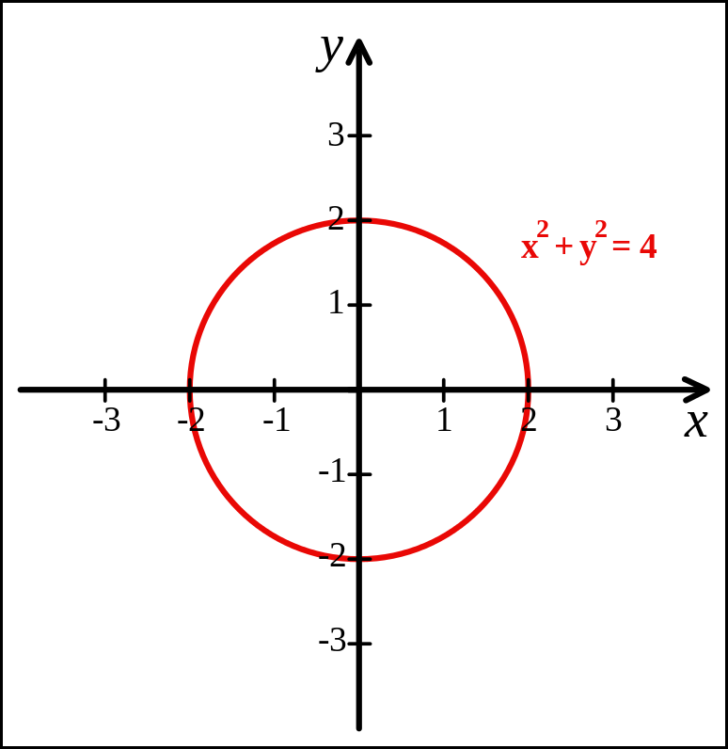
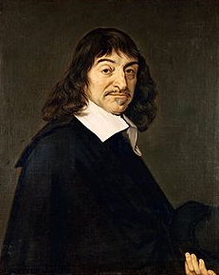
Cartesian Coordinates
Created by René Descartes in 1637

Slide 12
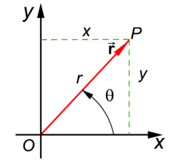
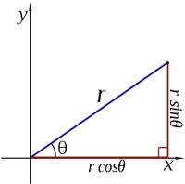
Polar Coordinates
A radius and an angle (theta)
make a 2D polar coordinate
$$(r∗\cos{θ, r ∗ \sin{θ)}}$$

Slide 13
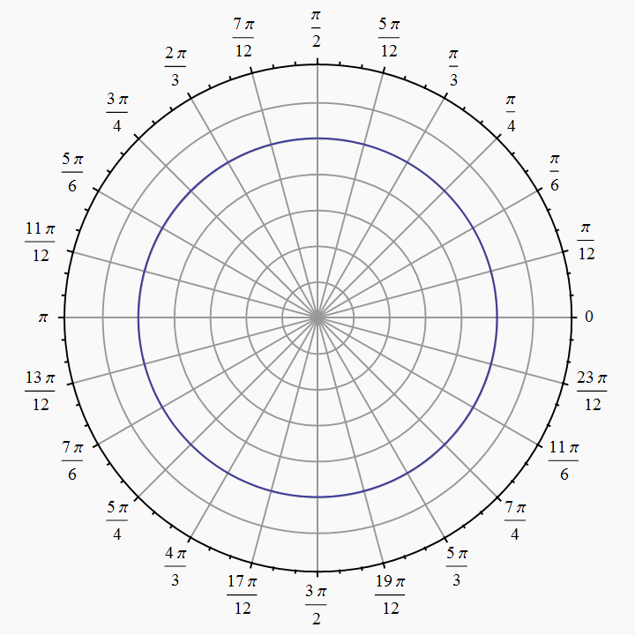
Polar Coordinates
Angles are measured in
radians
(0 ≤ θ ≤ $2π)$

Slide 14
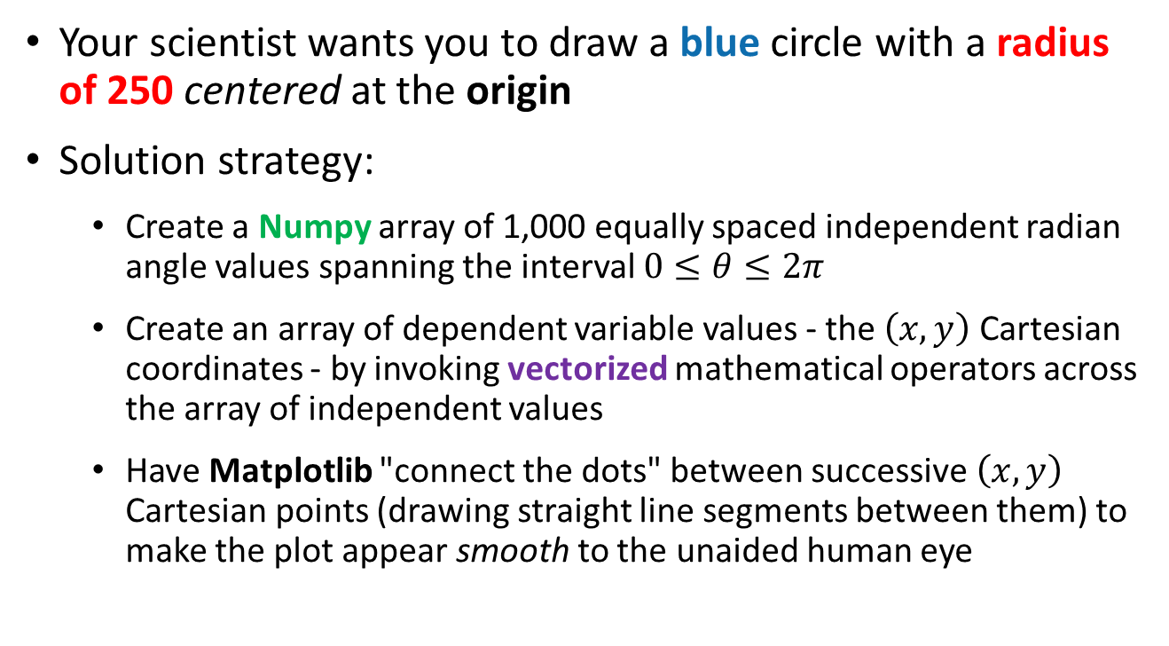
Polar to Cartesian Coordinate Conversion
Your scientist wants you to draw a blue circle with a radius of 250 centered at the origin
Solution strategy:
Create a Numpy array of 1,000 equally spaced independent radian angle values spanning the interval $0≤θ≤2π$
Create an array of dependent variable values - the $\left(x,y\right)$ Cartesian coordinates - by invoking vectorized mathematical operators across the array of independent values
Have Matplotlib "connect the dots" between successive $\left(x,y\right)$ Cartesian points (drawing straight line segments between them) to make the plot appear smooth to the unaided human eye

Slide 15
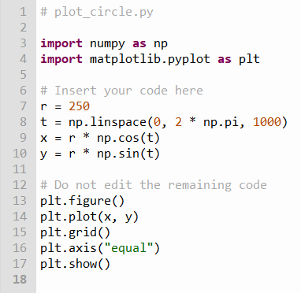
Edit plot_circle.py
①
②
③
④
⑤
⑥
⑦
⑧
⑨

Slide 16
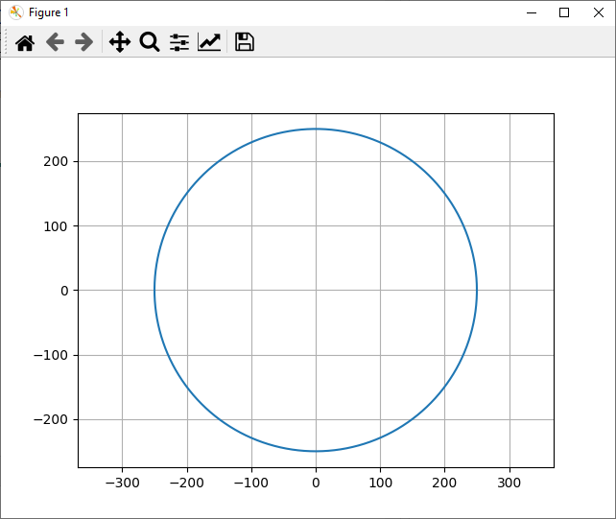
Run plot_circle.py

Slide 17
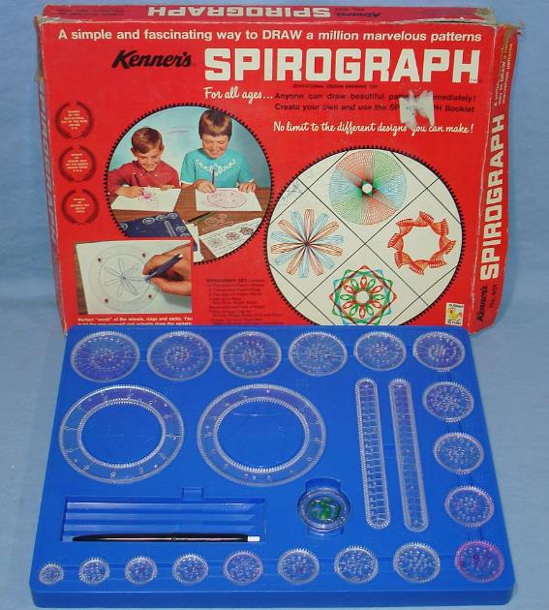
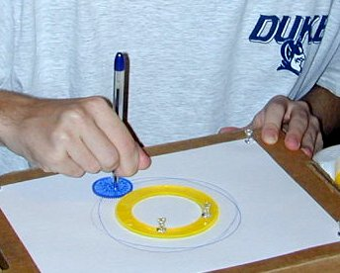
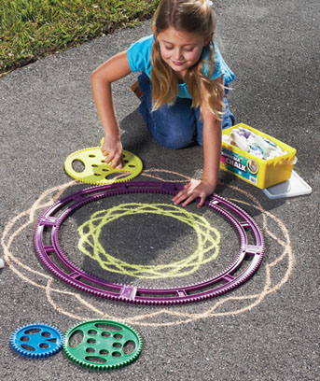
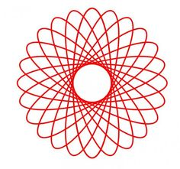
Parametric Curves

Slide 18
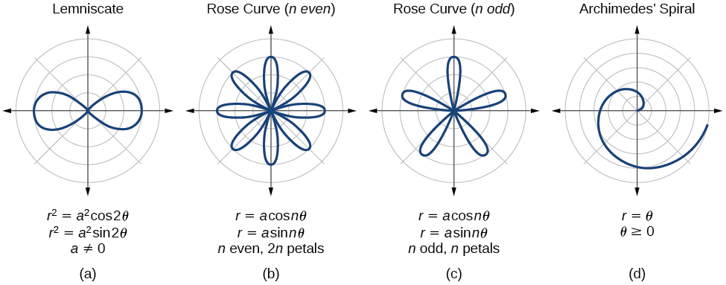
Parametric Curves
The two parameters a, n are used to calculate the current radius $r$ as $θ$sweeps the circle

Slide 19
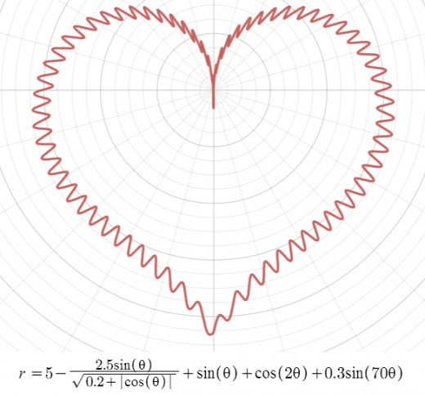
Parametric Curves

Slide 20
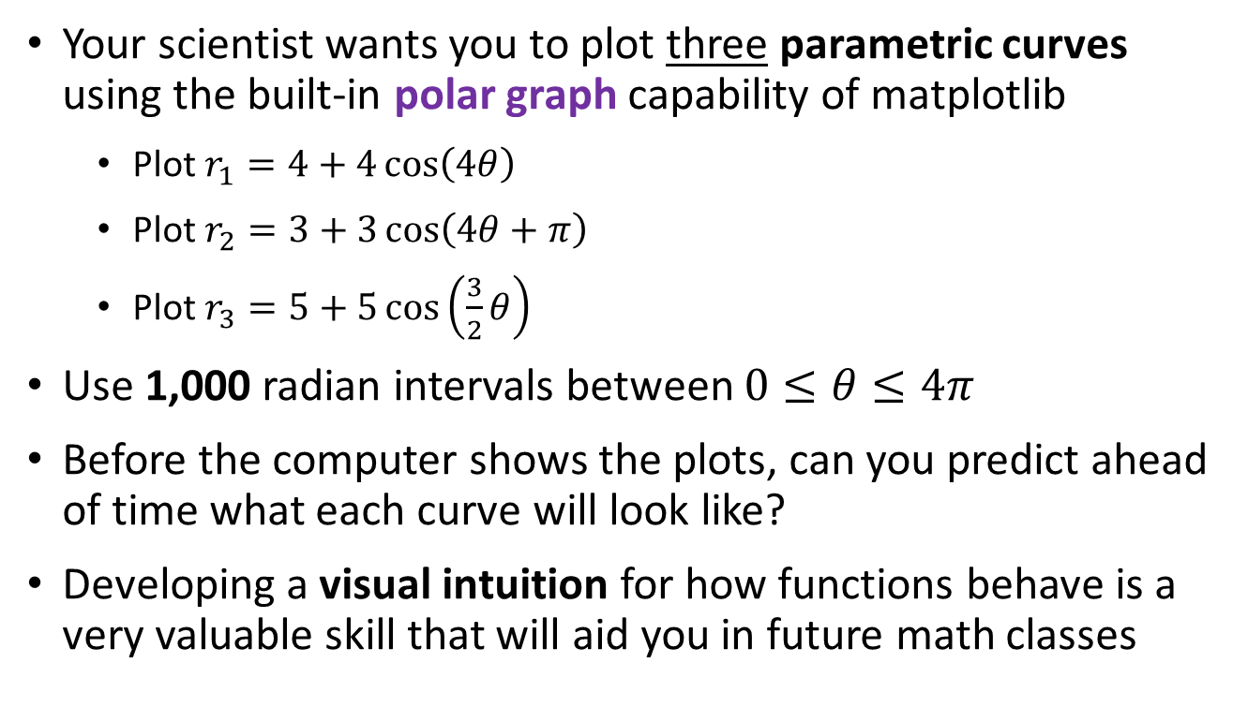
Parametric Curves Using Polar Graphs
Your scientist wants you to plot three parametric curves using the built-in polar graph capability of matplotlib
Plot $r_{1}=4+4\cos\left(4θ\right)$
Plot $r_{2}=3+3\cos\left(4θ+π\right)$
Plot $r_{3}=5+5\cos\left(\frac{3}{2}θ\right)$
Use 1,000 radian intervals between $0≤θ≤4π$
Before the computer shows the plots, can you predict ahead of time what each curve will look like?
Developing a visual intuition for how functions behave is a very valuable skill that will aid you in future math classes

Slide 21
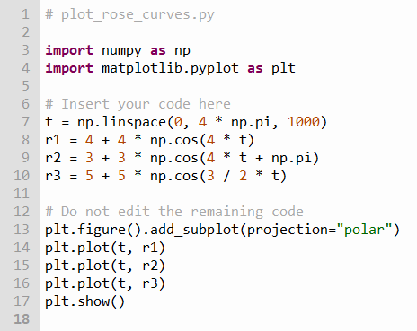
Edit plot_rose_curves.py
①
②
③
④
⑤
⑥
⑦
⑧
⑨

Slide 22
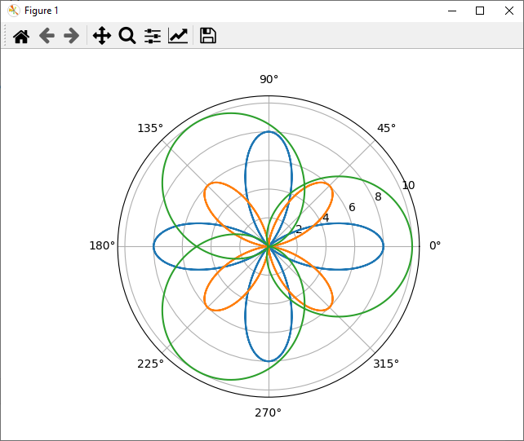

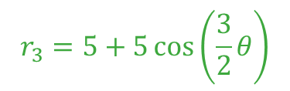

Run plot_rose_curves.py
$$r_{1}=4+4\cos\left(4θ\right)$$
$$r_{3}=5+5\cos\left(\frac{3}{2}θ\right)$$
$$r_{2}=3+3\cos\left(4θ+π\right)$$

Slide 23
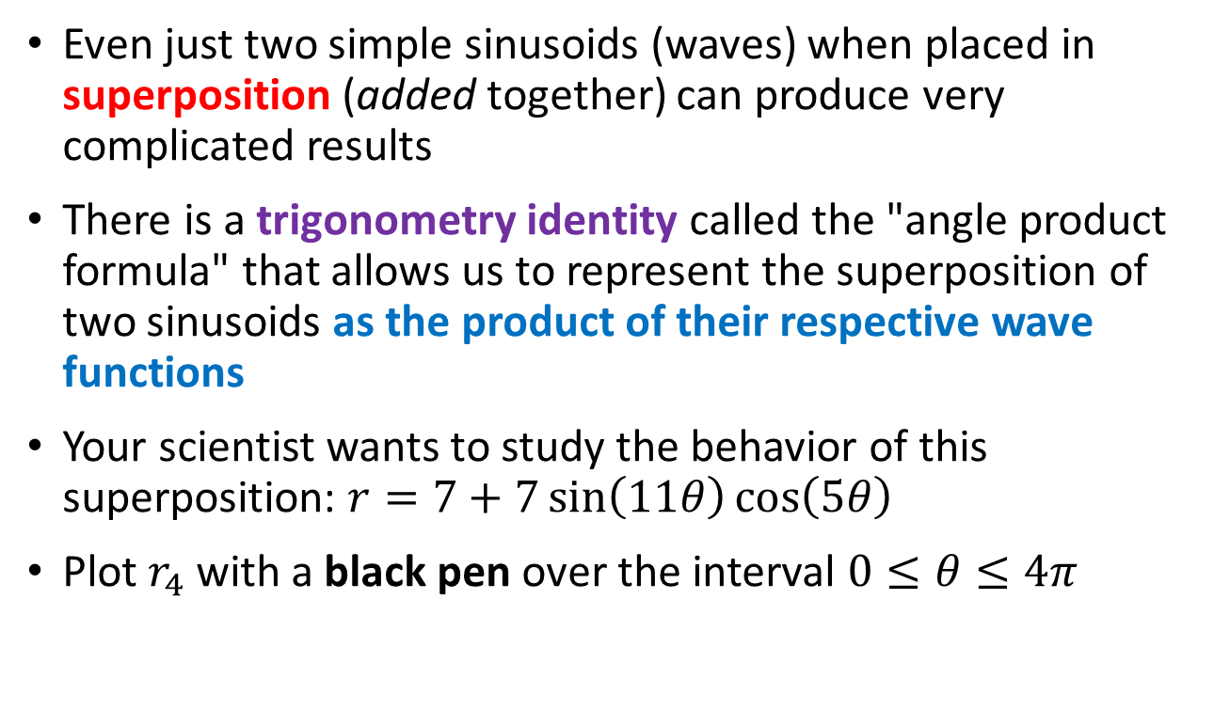
The Superposition of Waves
Even just two simple sinusoids (waves) when placed in superposition (added together) can produce very complicated results
There is a trigonometry identity called the "angle product formula" that allows us to represent the superposition of two sinusoids as the product of their respective wave functions
Your scientist wants to study the behavior of this superposition: $r=7+7\sin\left(11θ\right)cos\left(5θ\right)$
Plot $r_{4}$ with a black pen over the interval $0≤θ≤4π$

Slide 24
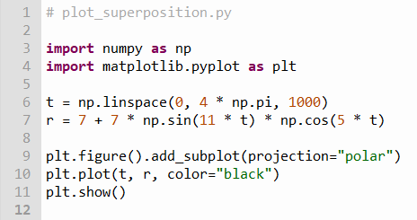




Open plot_superposition.py
Note: You should not edit this file!
$$0≤θ≤4π$$
①
②
③
$$r=7+7\sin\left(11t\right)\cos\left(5t\right)$$
Angle Product Identity
$$\sin{θ}\cos{φ}=\frac{\sin\left(θ+φ\right)+\sin\left(θ−φ\right)}{2}$$
$$7+7sin{11t}\cos{5t}=7+\frac{7}{2}\left[\sin\left(16t\right)+\sin\left(6t\right)\right]$$
Superposition

Slide 25
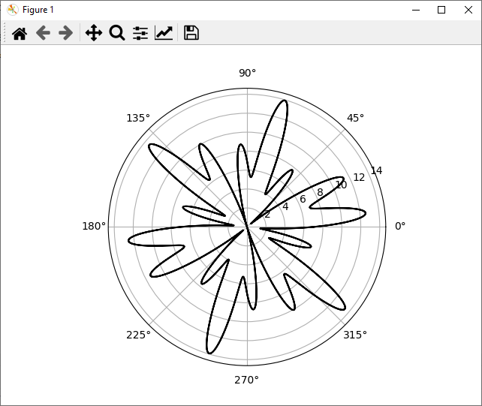
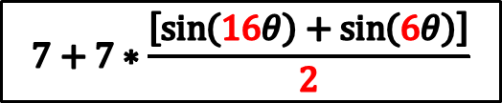
Run plot_superposition.py
$$7+7∗\frac{\left[\sin\left(16θ\right)+\sin\left(6θ\right)\right]}{2}$$
Even just two simple waves when added together can produce complicated results!

Slide 26
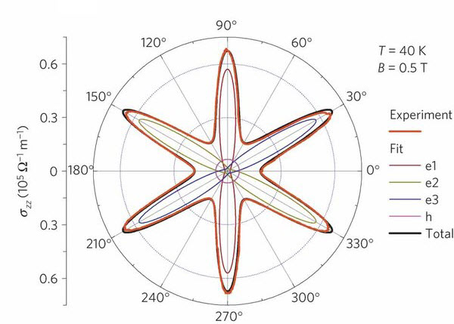
Parametric Curves
Field Induced Polarization of Dirac Valleys in Bismuth*
$$r=\sin^{2}\left(\frac{6}{5}θ\right)+\cos^{2}\left(\frac{6}{1}θ\right)$$
*Bismuth is the element with the highest atomic mass that is stable

Slide 27
Most of Physics is Waves
Biology
Chemistry
Physics
Math
Electrical
Magnetic
Acoustic
Heat Flow
Vibrational
Torsional
Nuclear / Quantum
Gravitational
Oceanic / Tidal
Orbital Precession
Springs
Pendulums
Tomography
Stock Market
Economics
Astronomical
Fluid Dynamics
Earthquakes
AC / DC
AM / FM
Speech
Heartbeats
It is important that you develop a keen
understanding of the mathematics of waves!

Slide 28
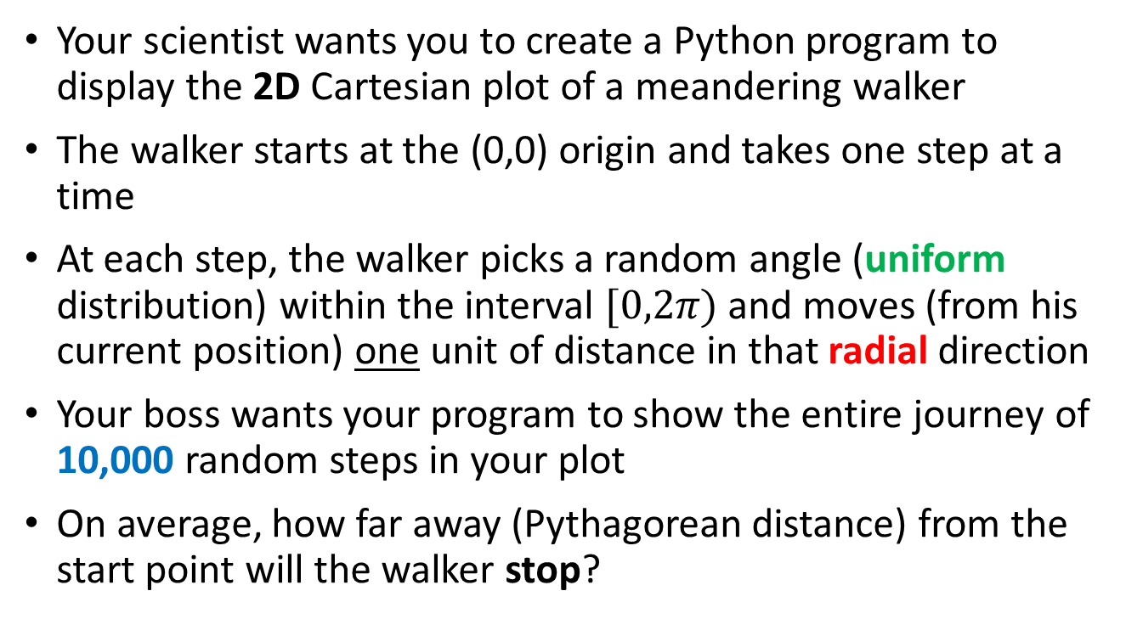
Random Walks
Your scientist wants you to create a Python program to display the 2D Cartesian plot of a meandering walker
The walker starts at the (0,0) origin and takes one step at a time
At each step, the walker picks a random angle (uniform distribution) within the interval $[0,2π)$ and moves (from his current position) one unit of distance in that radial direction
Your boss wants your program to show the entire journey of 10,000 random steps in your plot
On average, how far away (Pythagorean distance) from the start point will the walker stop?

Slide 29
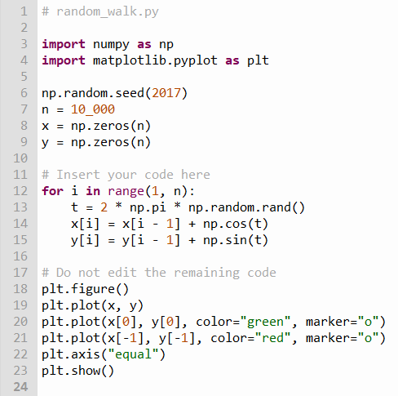
Edit random_walk.py
①
②
③
④
⑤
⑥
⑦
⑧
⑨
⑩

Slide 30
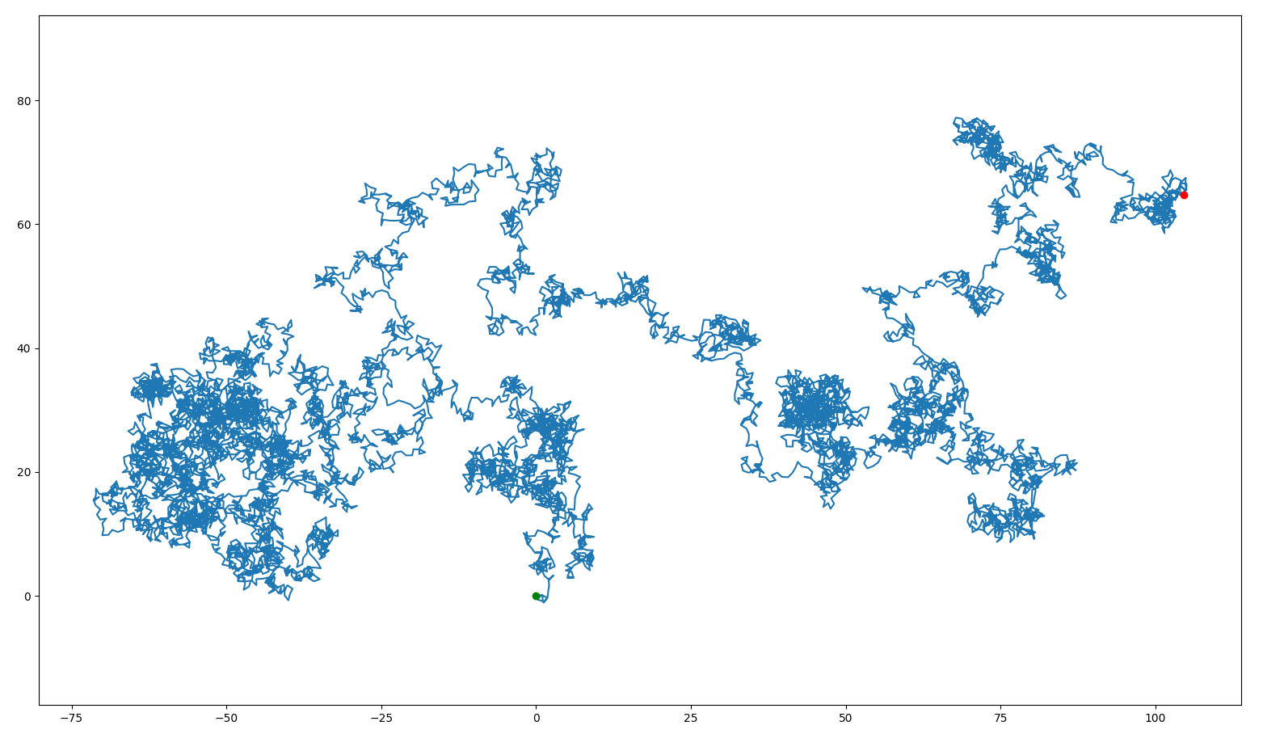
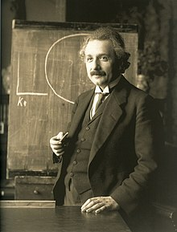

Run random_walk.py
Average final distance = $\sqrt{n}$
Stop
Start
Albert Einstein
(1879 – 1955)

Slide 31
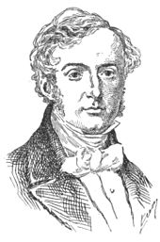
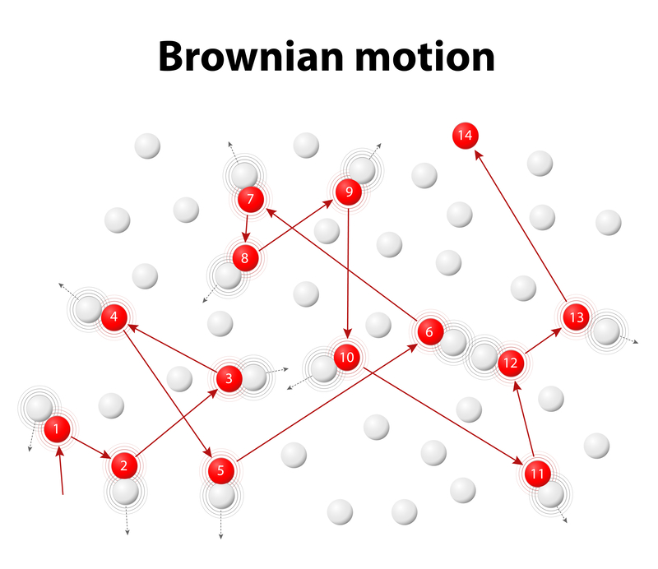
Robert Brown
(1773 – 1858)

Slide 32
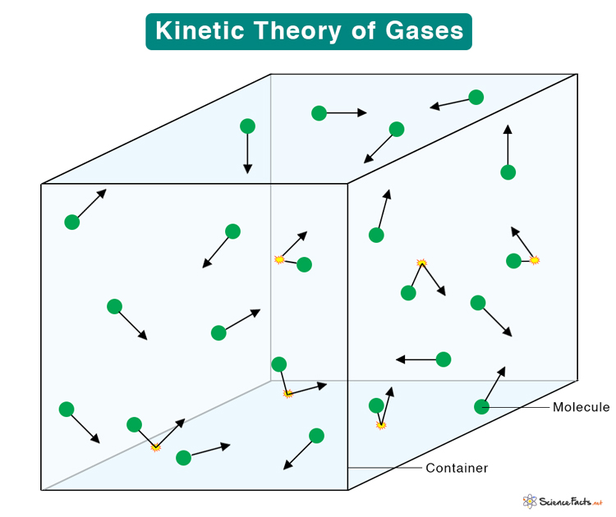

Slide 33
Session 06 – Now You Know…
Pixel colors are encoded as RGB channel integer triplets, but fortunately, the matplotlib package also recognizes standard color names when written in all lowercase letters
Graphs containing circles or spirals are often rendered much more easily as polar plots, instead of using the standard uniform (fixed grid) orthogonal Cartesian coordinate system
All waves can be characterized by their amplitude, frequency, phase, and offset
Even simple waves, when added together in superposition, can display remarkably complicated behavior - scientists must often unravel that perceived complexity to deduce the underlying simple waves driving the phenomenon

Slide 34

Task 06
Update the Python program called archimedes_spiral.py to display an Archimedes Spiral where $r=θ$
Using a pyplot polar graph, draw the entire spiral over the interval from $0≤θ≤10π$ subdivided into 1,000 steps

